Slide 1
Objectives
In this session, you will learn to:
  Create units of measure
  Create stock items
  Create inventory masters for National Traders
Notes:
Share the session objectives with the students.

Slide 2
Creating Units of Measure
Units of Measure:
  The following are the various types of unit of measures:
    Single
    Compound
  In Tally.ERP 9, the Unit of Measures should be created before creating the Stock Items.
Notes:
Share the session objectives with the students.

Slide 3

Creating Units of Measure (Contd.)
Give few examples of simple unit?
Notes:
You need to perform the step given under the following topic:
4.4.1 Creating Units of Measure
.

Slide 4

Creating Units of Measure (Contd.)
The various examples of simple units are nos., metres, kilograms
and pieces.
Notes:
You need to perform the step given under the following topic:
4.4.1 Creating Units of Measure
.

Slide 5
Creating Units of Measure (Contd.)
Give an example of compound unit?
Notes:
You need to perform the step given under the following topic:
4.4.1 Creating Units of Measure
.

Slide 6
Creating Units of Measure (Contd.)
A box of 10 pieces is an example of compound unit.
Notes:
You need to perform the step given under the following topic:
4.4.1 Creating Units of Measure
.

Slide 7
Creating Units of Measure (Contd.)
How can we create Units of Measure?
Notes:
You need to perform the step given under the following topic:
4.4.1 Creating Units of Measure
.

Slide 8
Creating Units of Measure (Contd.)
To create Units of Measure, you need to perform the following tasks:
Go to the Gateway of Tally > Inventory Info. > Units of Measure > Create
Notes:
You need to perform the step given under the following topic:
4.4.1 Creating Units of Measure
.

Slide 9
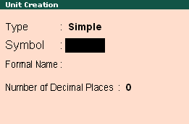
Creating Units of Measure (Contd.)
Creating Units of Measure:
  The following figure shows the Unit Creation screen.
Notes:
Share the session objectives with the students.

Slide 10
Creating Units of Measure (Contd.)
Let us see how to create a Unit of Measure.
Notes:
You need to perform the step given under the following topic:
4.4.1 Creating Units of Measure
.

Slide 11
Creating Stock Items
Stock Items:
  Are goods that are manufactured or traded (sell and purchase).
  Are the primary inventory entity.
  In the Inventory transactions are similar to ledgers being used in accounting transactions.
Notes:
Share the session objectives with the students.

Slide 12
Creating Stock Items (Contd.)
How can we create Stock Items?
Notes:
You need to perform the step given under the following topic:
4.4.1 Creating Units of Measure
.

Slide 13
Creating Stock Items (Contd.)
To create Stock Items, you need to perform the following tasks:
Go to Gateway of Tally >
Inventory Info. > Stock Items > Create
Notes:
You need to perform the step given under the following topic:
4.4.1 Creating Units of Measure
.

Slide 14
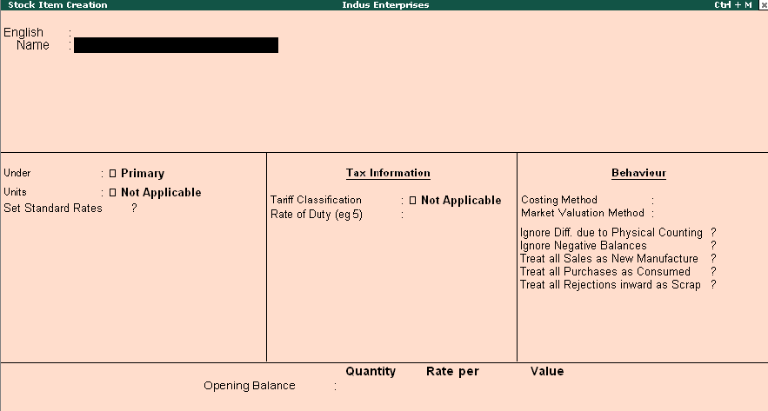
Creating Stock Items (Contd.)
Creating a Stock Item:
  The following figure shows the Stock Item Creation screen.
Notes:
Share the session objectives with the students.

Slide 15
Creating Stock Items (Contd.)
Let us see how to create a
Stock Item.
Notes:
You need to perform the step given under the following topic:
4.5.1 Creating a Stock Item

Slide 16
Creating Inventory Masters for National Traders
Let us see how to create Inventory Masters for National Traders.
Notes:
You need to perform the step given under the following topic:
4.6 Creating Inventory Masters for National Traders

Slide 17
Summary
In this session, you learnt that:
  Units of Measure is a unit to measure the quantity of stock items.
  Stock Items are goods that you manufacture or trade (sell and purchase).

